Slide 1
JavaDocs
Creating Comprehensive Codebase documentation

Slide 2
What are JavaDocs?
JavaDocs are comments written using a specific format that you include in your Java class
These comments can then be used by a JavaDoc compiler to generate an API for that class
Example of JavaDocs: The Java online API

Slide 3
Where are JavaDocs Written?
JavaDocs are written in two main locations:
Above a class signature (class comment)
Above a method signature (method comment)
Class comments indicate what a class is used for.
Method comments indicate what a method is used for.

Slide 4
What is the Format of a JavaDoc Comment?
All JavaDoc comments work should be structured around the same basic format:
Open JavaDoc comment block using /**
Single sentence (terminated with full stop) giving brief summary of the method/class functionality.
Paragraph giving longer description of the method/class functionality (using HTML for any formatting you wish to include)
Tags detailing specifics of the class/method
Close JavaDoc block using */
Style note: To avoid line wrapping interfering with your comment formatting, make sure to break lines at the 80 character mark.

Slide 5
Example of a JavaDoc Method Comment
Notation to begin a JavaDoc comment
/**
* Retrieves the Customer matching a supplied name.
*
* Iterates through the supplied array to find the customer * with the same name as that supplied as a parameter.
*
* @param Customer [] custList An array of Customers * to be searched
* @param String nameToLookFor The name of the Customer * being searched for
*
* @return A Customer object matching that name, * or null if no match was found
*/
public Customer searchByName(Customer[] custList,
String nameToLookFor){
Summary of the method’s functionality
Auto-inserted
Expanded explanation of functionality
Tag information
End of Comment
Method begins

Slide 6
Tag Types
Tags are included to explain a specific entity involved in the code in more detail, for example:
Explain what a specific parameter is used for
Explain what the possible return values are and what they mean
We will focus on a subset of tags
@param : Indicates that the line of text is discussing one of the method’s parameter.
You should include one for each parameter taken in by the method (in the order they appear in the method’s brackets)
These define your algorithm’s INPUTS
@return: Indicates that the line of text is discussing the method’s return value
This is usually defining, and explaining, your algorithm’s OUTPUT
@throws: Indicates that the line of text is discussing an exception that can be thrown by the method
You should include one for each possible exception that can be thrown (in alphabetical order)

Slide 7
Using Tags
When using tags, the correct format is:
@tagName entity name explanation of entity
Component explanations:
tagName: The tag you are using (e.g. param, return etc.)
Entity name: the name of entity being discussed (e.g. the name of the parameter you are explaining)
Explanation of entity: Your explanation of that entity (e.g. what the parameter you are explaining does)
Examples:
@param position The position of the item to be retrieved
@throws IndexOutOfBoundsException Thrown if the position supplied is outside the boundaries of the array

Slide 8
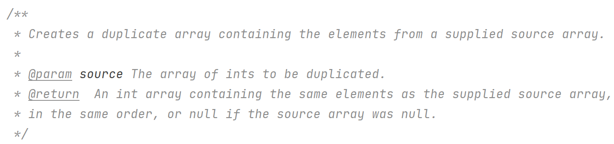
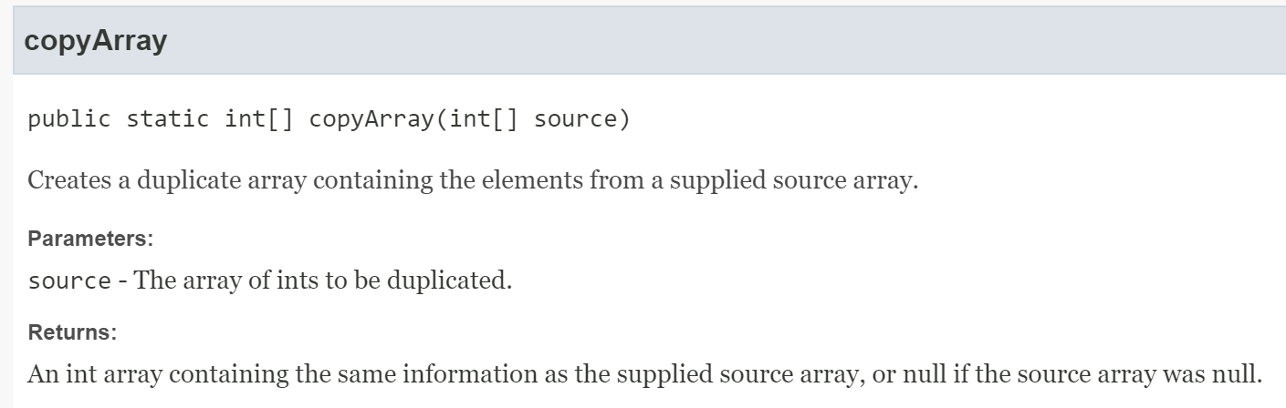
Another JavaDoc Comment & the Corresponding API Entry
PRODUCES

Slide 9
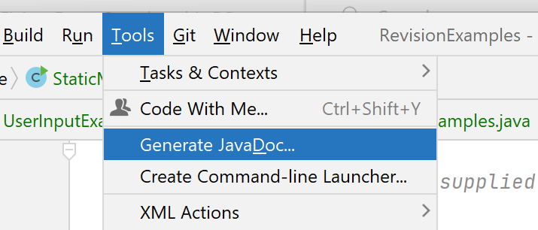
Generating JavaDoc APIs in IntelliJ
IntelliJ contains a built-in JavaDoc API generator

Slide 10
Expectations With Regard to JavaDocs
You are expected to provide JavaDocs in any submitted code
Ongoing exercises
Project
Lab exam
Your JavaDocs should be reasonably detailed
Include a brief, 1 line explanation of what the method does
Include a longer explanation where the method has some subtleties
Your JavaDocs should use tags (and include explanations)
@param where parameters appear in your method
@returns where the method returns something
@throws where the method throws an exception (will see more of this later)

Slide 11
Not a Valid JavaDoc Comment – Why?
/**
* Searches for a Customer
*
* @param Customer [] custList
* @param String nameToLookFor
*
* @return Customer
*/
public Customer searchByName(Customer[] custList, String nameToLookFor){
How do you fix this??

